Slide 1
Strategies for Reuse of Launch Vehicle First Stages
Are any first stage reuse strategies economically worthwhile?
… under what mission, market, and technological conditions?
Matthew Vernacchia
Kelly Mathesius
2018-10-03

Slide 2
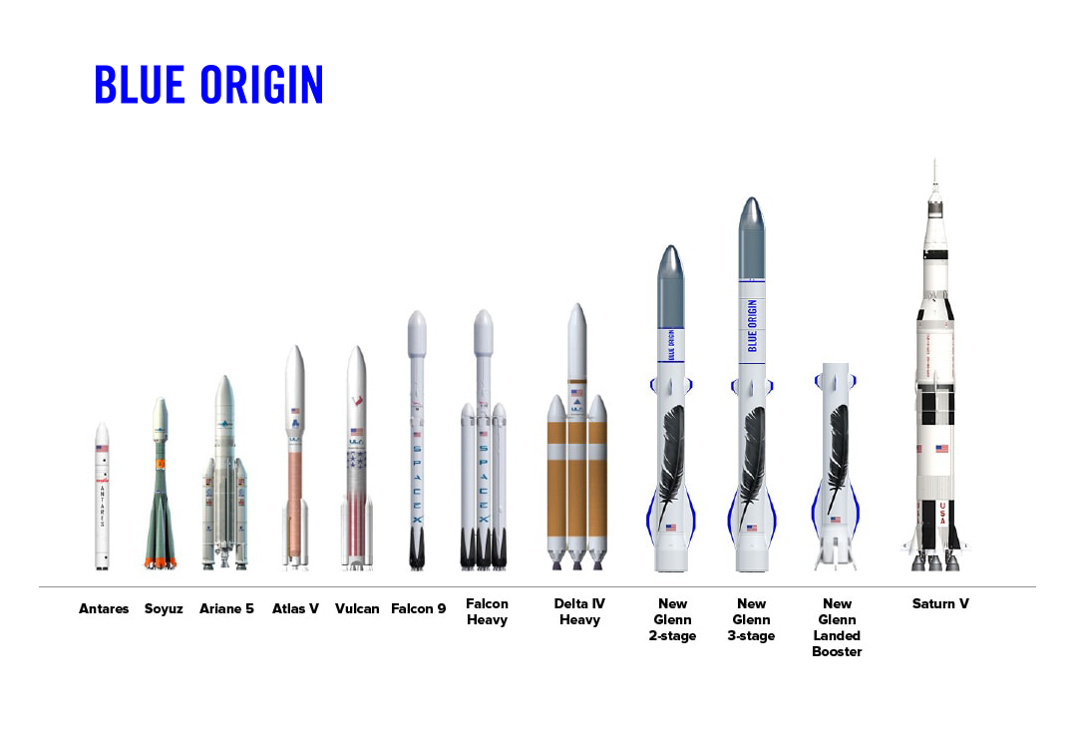
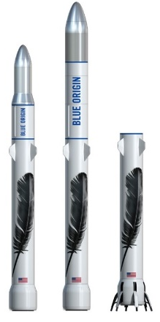
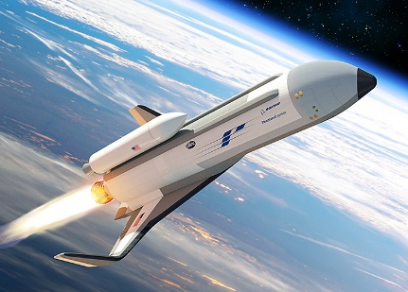
Some launch providers are moving towards reusability
Will providers of expendable launch vehicles be left behind?
… or are these development efforts wasting billions?
SpaceX
Falcon 9
Operational
Blue Origin
New Glenn
In development
ULA
Vulcan SMART reuse
In development
Boeing
XS-1 Phantom Express
In development
Intro | 1. Production costs | 2. Lowest-cost strategy | 3. Conditions for reuse viability | Conclusion

Slide 3
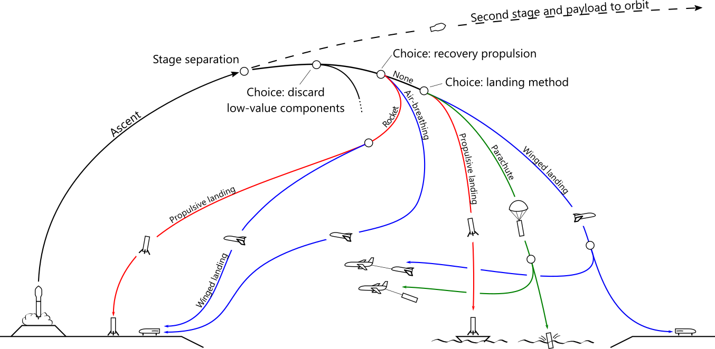
Many first stage reuse strategies have been proposed …
… but their performance and cost have not been (publically) compared under a common framework
… and there remains controversy as to which, if any, are economically worthwhile
Examples:
Falcon 9
USAF RBS
Baikal
Vulcan SMART
Falcon 9
New Glenn
Ares I
XS-1 Phantom Express
Launch site recovery
Downrange recovery
Intro | 1. Production costs | 2. Lowest-cost strategy | 3. Conditions for reuse viability | Conclusion

Slide 4
We modeled the performance and cost of these strategies while accounting for uncertainty
Classify reuse strategies
Model performance: Tsiolkovsky
Model cost: TRANSCOST 8.2
Quantify uncertainty: Monte Carlo methods
Intro | 1. Production costs | 2. Lowest-cost strategy | 3. Conditions for reuse viability | Conclusion

Slide 5
First stage reuse can be economically worthwhile
First stage production cost drives the high cost per flight of expendable vehicles (for large vehicles)
Downrange propulsive landing is likely the lowest-cost strategy
1st stage reuse is worthwhile only for large payloads and high launch rates
Intro | 1. Production costs | 2. Lowest-cost strategy | 3. Conditions for reuse viability | Conclusion

Slide 6
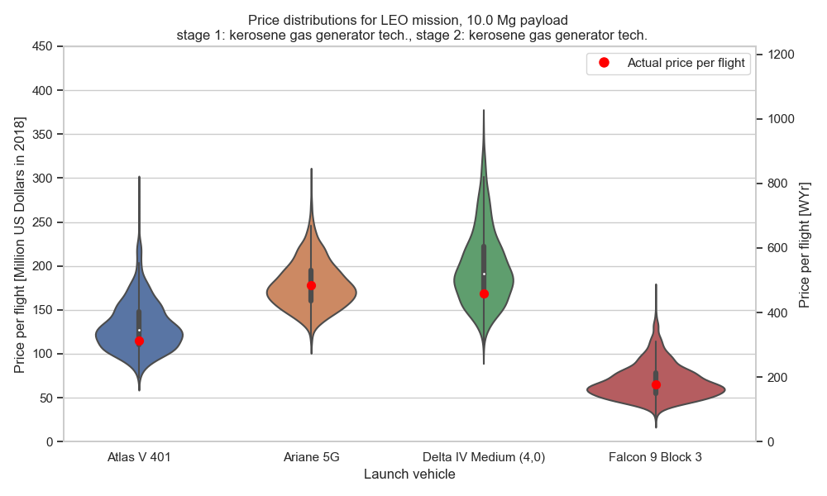
Cost model estimates are credible
Intro | 1. Production costs | 2. Lowest-cost strategy | 3. Conditions for reuse viability | Conclusion

Slide 7
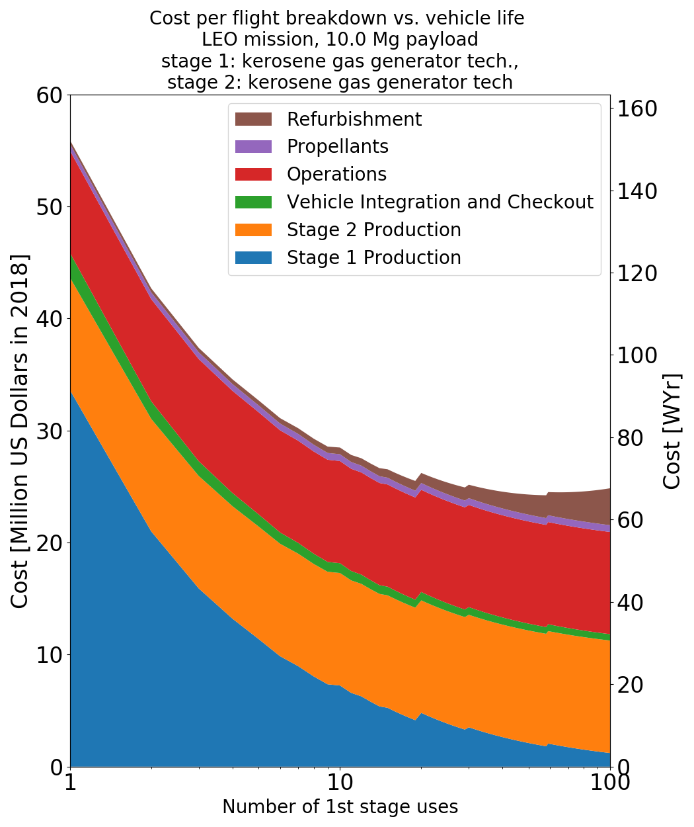
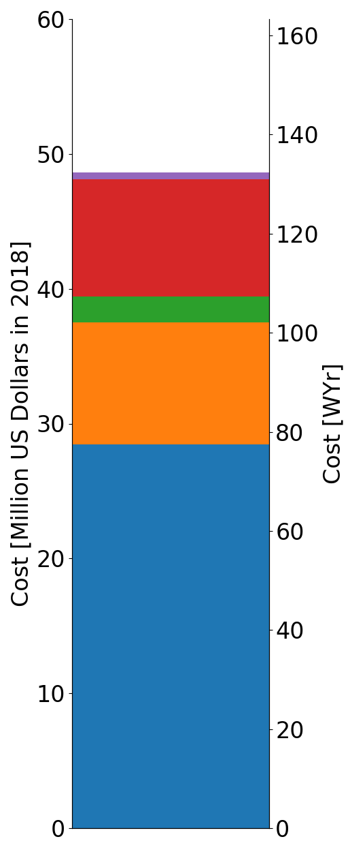
First stage production cost drives cost per flight
Expendable
With first stage reuse
reuse
LEO mission, 10 Mg payload
stage 1&2: kerosene gas gen. tech.
Intro | 1. Production costs | 2. Lowest-cost strategy | 3. Conditions for reuse viability | Conclusion

Slide 8
Different reuse strategies result in different vehicle masses and costs
Reuse:
Adds mass to the first stage
Reduces the payload mass fraction
Recovery hardware
Estimate payload mass fraction
Estimate element masses
Estimate cost
Recovery propellant
Payload mass fraction
=
Intro | 1. Production costs | 2. Lowest-cost strategy | 3. Conditions for reuse viability | Conclusion

Slide 9
All reuse strategies reduce the payload mass fraction
Intro | 1. Production costs | 2. Lowest-cost strategy | 3. Conditions for reuse viability | Conclusion

Slide 10
Downrange propulsive landing has lowest estimated cost
Lowest estimated cost
Intro | 1. Production costs | 2. Lowest-cost strategy | 3. Conditions for reuse viability | Conclusion

Slide 11
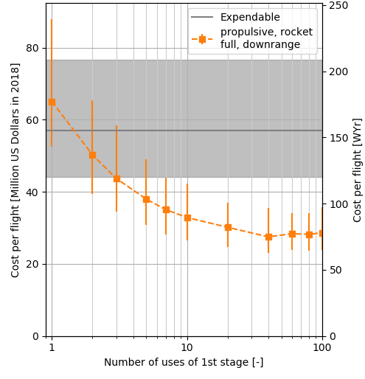
Cost decreases with number of reuses … up to a point
Confidently cheaper than expendable:
> ~5 uses
Realize most of cost savings:
> ~20 uses
Cost increases due to refurbishment:
> ~60 uses
5
20
60
LEO mission, 10 Mg payload
stage 1&2: kerosene gas gen. tech.
Intro | 1. Production costs | 2. Lowest-cost strategy | 3. Conditions for reuse viability | Conclusion

Slide 12
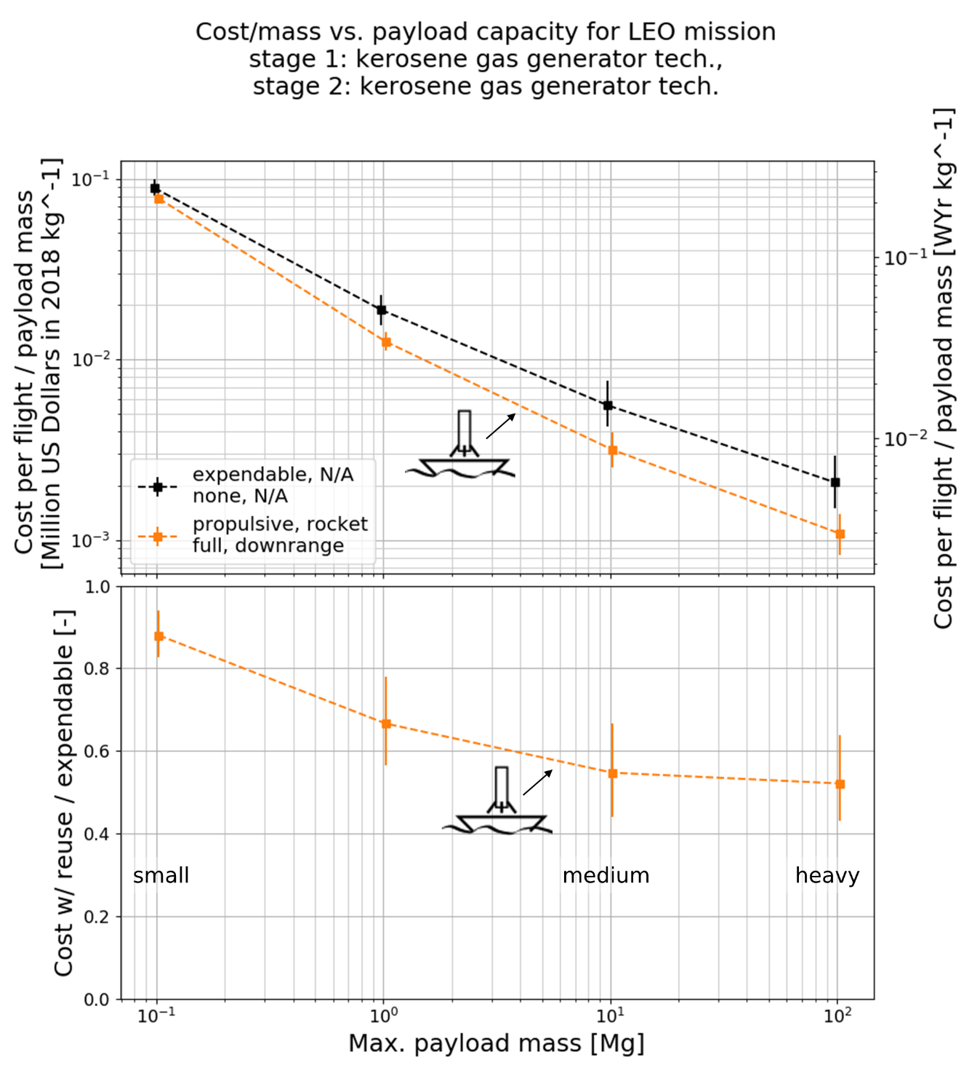
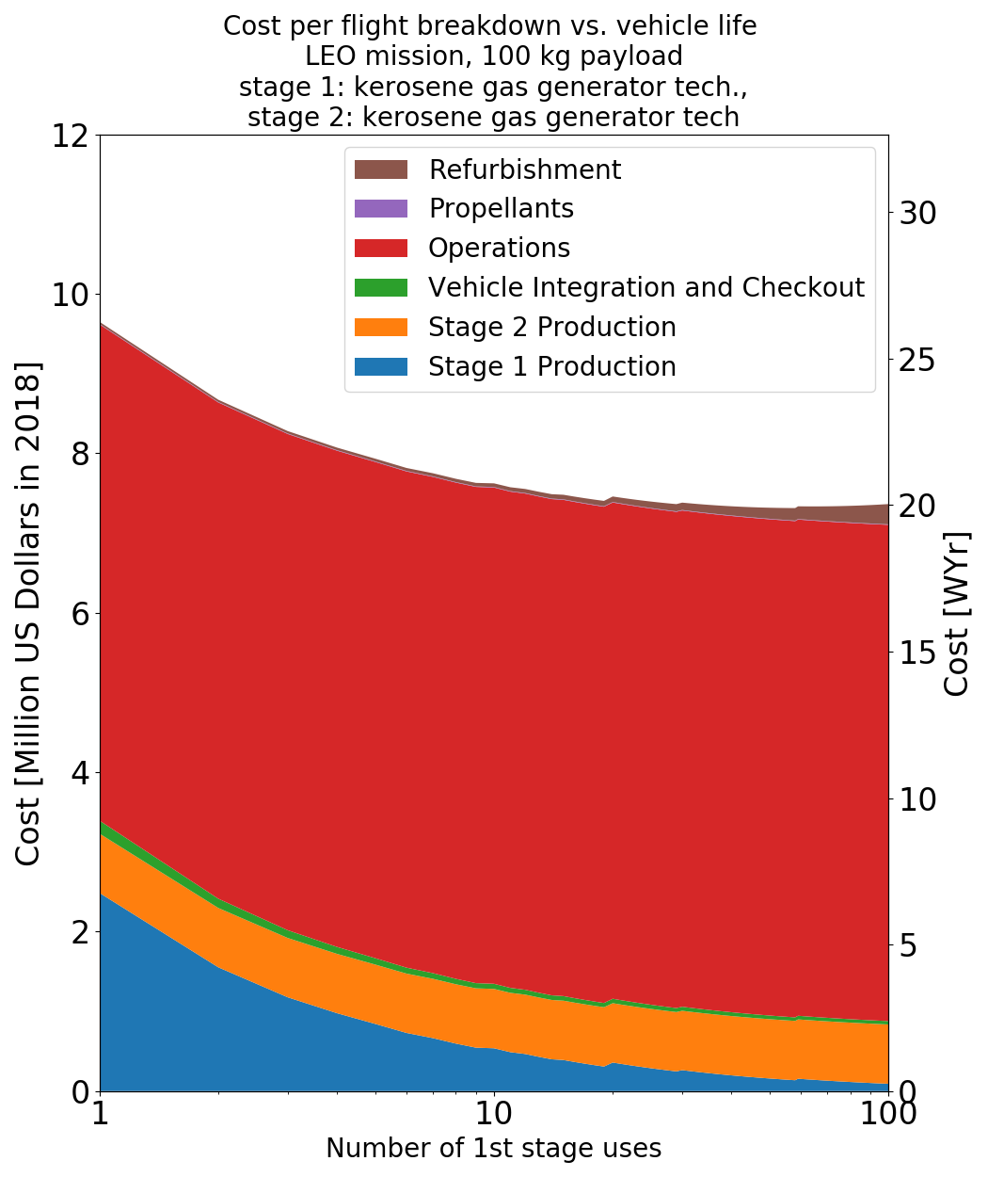
Reuse is only viable for medium to heavy launch vehicles
Small 100 kg payload
Medium 10 Mg payload
LEO mission
stage 1&2: kerosene gas gen. tech.
Intro | 1. Production costs | 2. Lowest-cost strategy | 3. Conditions for reuse viability | Conclusion

Slide 13
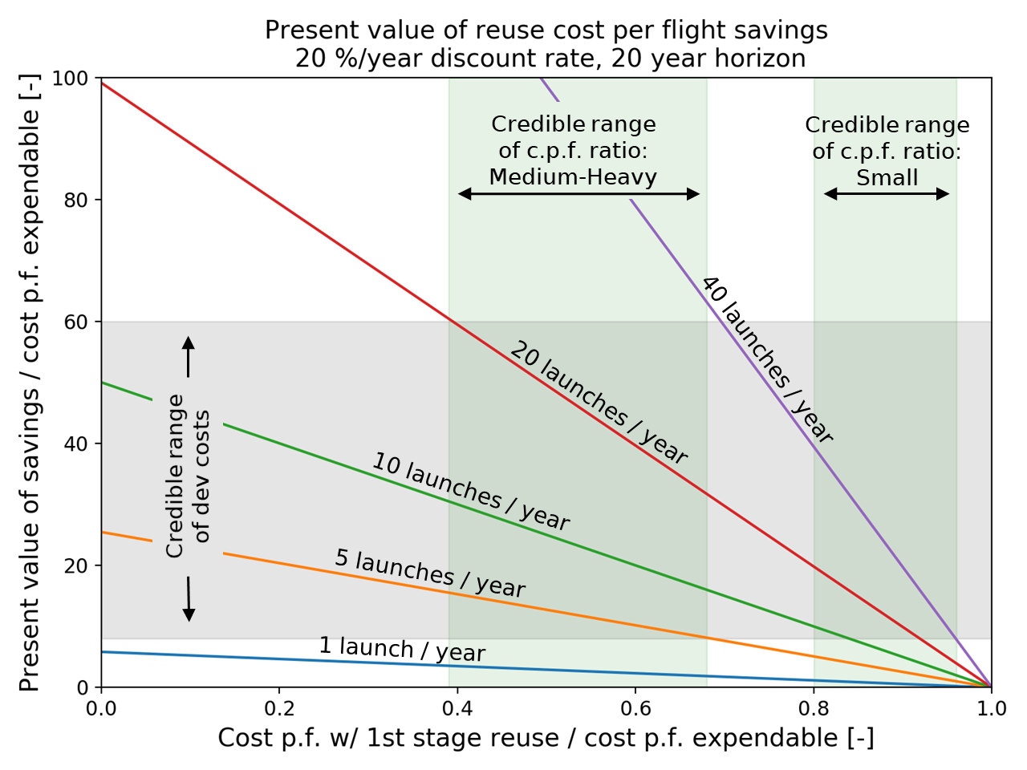
High launch rates enable reuse development to be paid off
Intro | 1. Production costs | 2. Lowest-cost strategy | 3. Conditions for reuse viability | Conclusion

Slide 14
Conclusion: Some 1st stage reuse strategies, particularly downrange propulsive landing, can be economically worthwhile
Only worthwhile for medium-large launch vehicles, where first stage production costs dominate
Downrange propulsive landing is likely the lowest-cost strategy
Partial (engines-only) reuse strategies have small potential savings
Winged stages have uncertain (and probably high) production costs
High launch rates (> 20/year) are likely needed to pay off development costs
Intro | 1. Production costs | 2. Lowest-cost strategy | 3. Conditions for reuse viability | Conclusion

